Slide 1
Chapter-2
Microprocessor Architecture and Microcomputer System
Microprocessor
A microprocessor is programmable logic device, designed with registers, flip-flops, and timing elements. It is a single chip made by LSI or VLSI technology. It is the CPU of a microcomputer.
Microprocessor Unit (MPU)
In early processors the different units of a CPU are made not in a single chip rather in different separate chips.These group of chips are called a Micro Processor Unit (MPU).

Slide 2
2.1 MICROPROCESSOR ARCHITECTURE AND ITS
OPERATIONS
Architecture of Microprocessor
The internal logic diagram of a microprocessor is called its architecture.
Different Categories of Functions Performed by a Microprocessor
All the various functions performed by the microprocessor can be classified in three categories:
Microprocessor-initiated operations.
Internal data operations.
Peripheral (or externally) initiated operations.

Slide 3
2.1.1 Microprocessor-Initiated Operations
The MPU performs primarily four operations:
Memory Read: Reads data from memory.
Memory Write: Writes data into memory.
I/O Read: Accepts data from input devices.
I/O Write: Sends data to output devices.
Steps to Communicate with Peripherals or Memory Location
To communicate with a peripheral or a memory location, the MPU needs to perform the following steps:
Step 1: Identify the peripheral or the memory location (with its address)
Step 2: Transfer data.
Step 3: Provide timing or synchronization signals.

Slide 4
2.1.2 Internal Data Operations and the 8085/8080A Registers
The internal architecture of the 8085/8080A microprocessor determines how and what operations can be performed with data. These operations are:
Store 8-bit data
Perform arithmetic and logical operations.
Test for conditions.
Sequence the execution of instructions.
Store data temporarily during execution in the defined R/W memory locations called the stack.

Slide 5
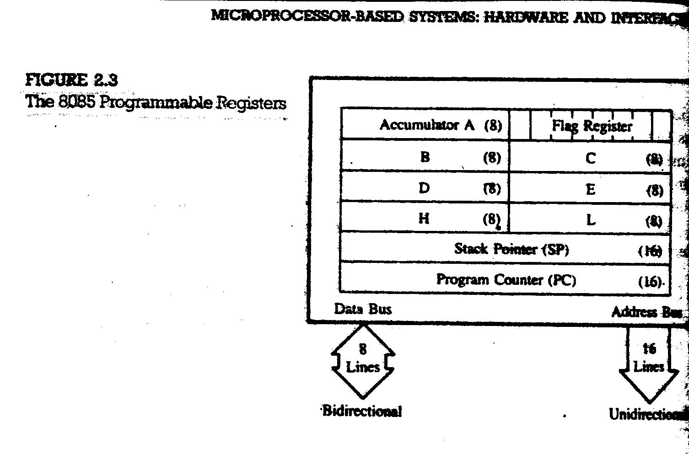

Slide 6
2.1.3 Peripheral or Externally Initiated Operations
External devices (or signals) can initiate the following operations for which individual pins on the microprocessor chip are assigned:
Reset: When all internal operations are suspended and the program counter(PC) is cleared (0000H).
Interrupt: Microprocessor can be interrupted from the normal execution and asked to execute some other instructions called service routine. After completing service routine it resumes its operation.
Ready: If the signal of 8085/8080A READY pin is low, the microprocessor enters into a Wait state. The pin is used to synchronize with slower peripherals with microprocessor.
Hold: When the HOLD is activated by an external signal, the microprocessor give up control of system bus for external peripheral to use them. For example, HOLD signal is used in DMA data transfer.

Slide 7
